Slide 1
FDP on Agentic AI: Foundations, Applications, and Future Directions
“Exploring the Power of Agentic AI with IBM Granite and LangFlow”

Slide 2

Name of the team: SKYMINDS
Details of Team members
TEAM MEMBER NAME | Recent Passport Photo | Email ID | Phone number [WhatsApp]
Renuka S. Deshpande |  | renukadeshpande1`920@gmail.com | 9075760286

Slide 3

Rag Based AICTE Rules & Regulations Engine
The Challenge Students, faculty, and institutions often struggle to understand AICTE rules, mandatory requirements, approvals, and online procedures. Information is spread across large PDFs, circulars, and websites — leading to confusion, delays, and compliance issues.
Manual searching is time‑consuming and error‑prone.
There is no single intelligent platform to query AICTE policies instantly.

Slide 4
Research work
• Studied AICTE Approval Process Handbook, Circulars, and Regulations.
• Explored Retrieval-Augmented Generation (RAG) for policy extraction.
• Identified limitations of traditional search vs. AI-based semantic retrieval.
• Analysed IBM Granite model performance on regulatory and formal texts.
• Designed a LangFlow-based pipeline for question answering.

Slide 5

The AICTE Rules & Regulations Engine is an Agentic AI system that:
• Accepts natural language queries about AICTE rules.
• Uses RAG to fetch relevant policy documents.
• Uses IBM Granite LLM for accurate, regulation-safe answers.
• Provides instant guidance on processes and required documents.
• Built on IBM LangFlow for modular, transparent pipeline design.

Slide 6
Langflow component Used
1) Chat Input – captures user queries.
2) IBM Watsonx AI Agent – processes queries with RAG + Granite model.
3) File Component – stores AICTE PDFs for retrieval.
4) Chat Output – displays final answers.
5) Text Splitter – divides documents for efficient chunking.
6) Vector Store – maintains embeddings for RAG search.

Slide 7
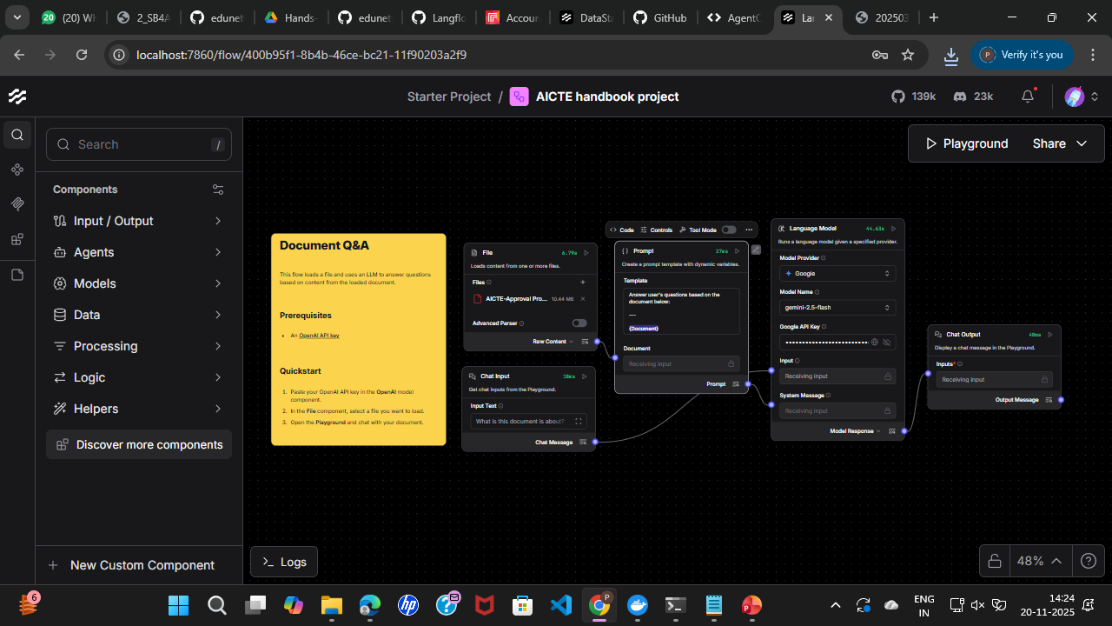
Workflow

Slide 8

Architecture blueprint

Slide 9
Role of Agentic AI in your solution
Agentic AI enables:
• Autonomous retrieval of the correct AICTE rules.
• Self‑correction through grounded policy references.
• Workflow orchestration via LangFlow agents.
• Reduction of hallucination using RAG.
• Policy‑compliant, accurate responses.

Slide 10
Technology Used
Langflow platform
Langflow component – Agent , Chat input , Chat output
IBM Grainte model - for eg – ibm-granite-3-2-8b
IBM Cloud
RAG

Slide 11
Novelty and Uniqueness
·• First platform dedicated to AICTE regulations using RAG.
• Converts large policy PDFs into searchable AI responses.
• Granite‑supported compliance to avoid misinformation.
• Instant answers to rules, approvals, and document requirements.
• Reduces dependency on manual reading of hundreds of pages.
·

Slide 12
Git Hub Link
https://github.com/renukadeshpande20/fdp_project_aicte_rules_regulations.git
·
·
·

Slide 13
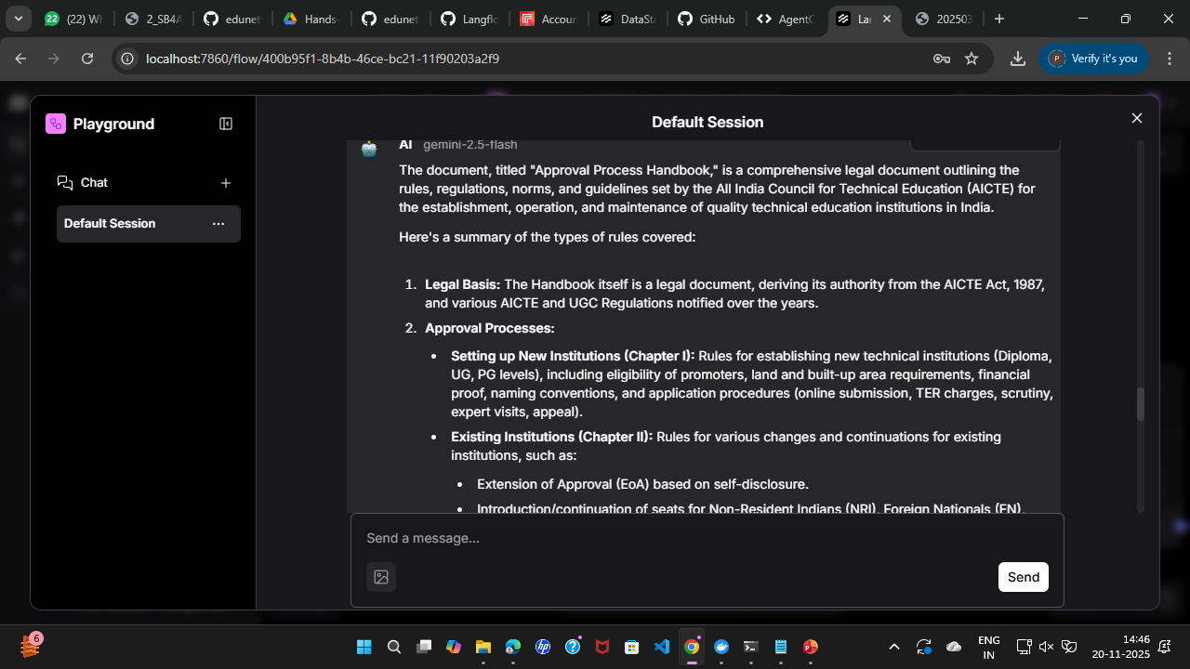
Output Screen shots
·
·
·

Slide 14
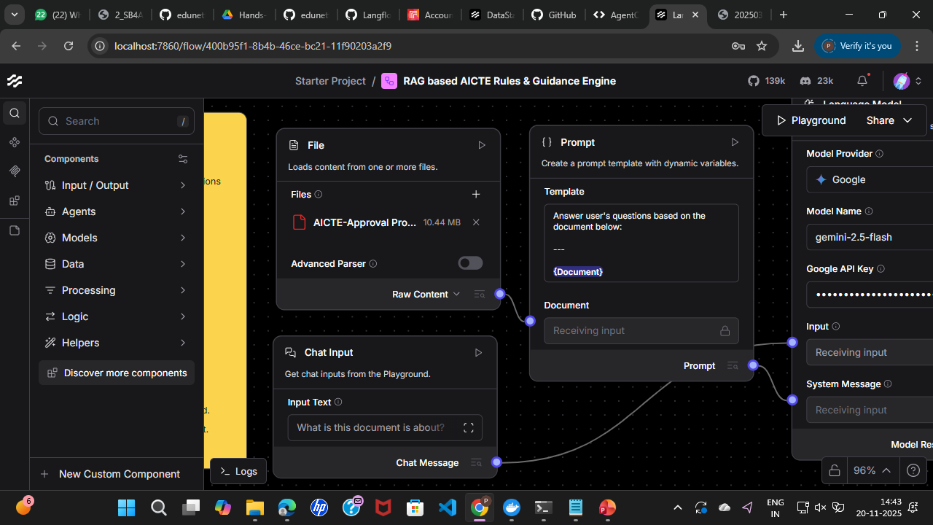

Slide 15
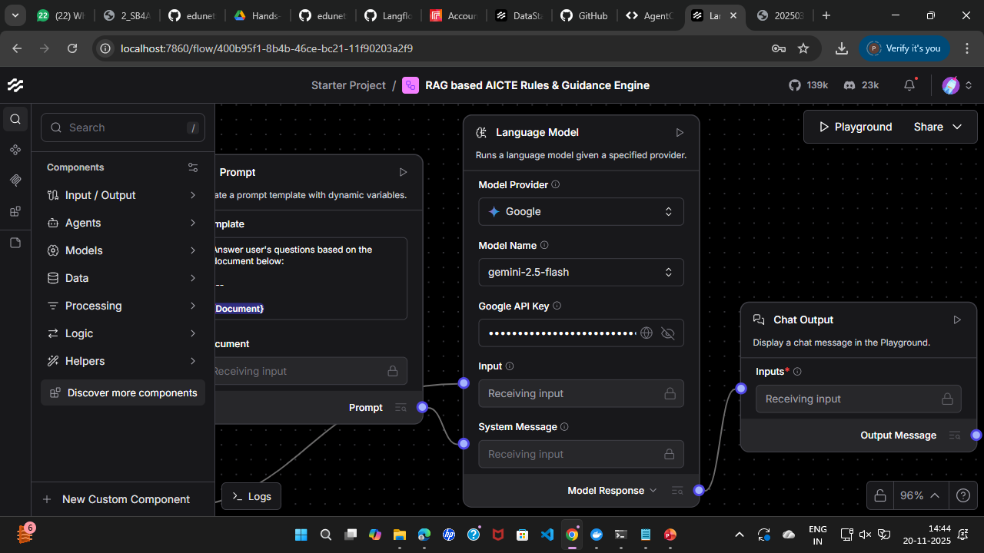

Slide 16
Future Scope
·
• Support for NBA, NAAC, UGC policies.
• Multilingual interface for Indian institutions.
• Voice-based AI assistant.
• Real‑time updates from AICTE website.
• Mobile app for faculty and students.
·
·
·

Slide 17


